Slide 1
CineScope - Movie Data Visualization
Group 14
Course Instructor : Dr. Soumya Dutta

Slide 2
Application Domain
The movie industry is a dynamic and ever-evolving landscape, deeply connected to cultural trends, technological advancements, and shifting audience preferences. With the explosion of streaming platforms and online rating systems, a massive amount of movie-related data is now readily available. However, navigating and making sense of this vast information can be overwhelming. To bridge this gap, we propose a data-driven visualization platform — CineScope — that helps users explore movie trends, rating behaviors, and financial performances interactively. By leveraging rich metadata, user ratings, and industry figures, our platform empowers movie enthusiasts, researchers, and industry professionals to make informed analyses, uncover hidden patterns, and gain a deeper understanding of cinematic evolution over time.

Slide 3
Data Source
We sourced our data from the Kaggle dataset ”The Movies Dataset”, which com piles extensive movie metadata primarily from the TMDB (The Movie Database) API. This dataset also integrates user rating information derived from the MovieLens project, offering a rich combination of movie attributes and audience engagement data for com prehensive analysis.
References
https://www.kaggle.com/datasets/rounakbanik/the-movies-dataset

Slide 4
Genre Evolution Over Time

Slide 5
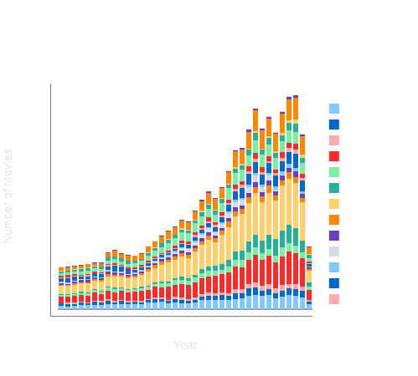
Stacked Bar Chart

Slide 6
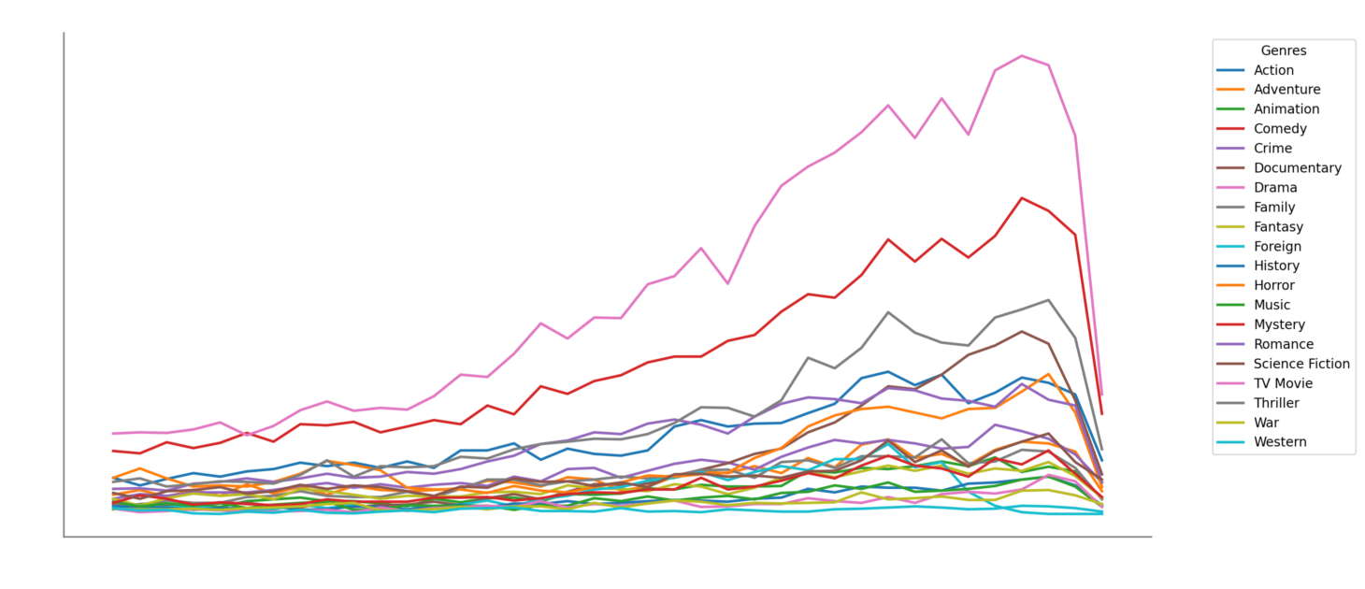
Line Chart

Slide 7
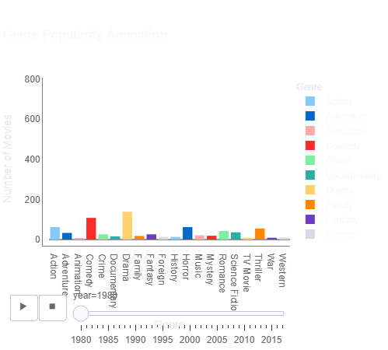
Bar Chart

Slide 8
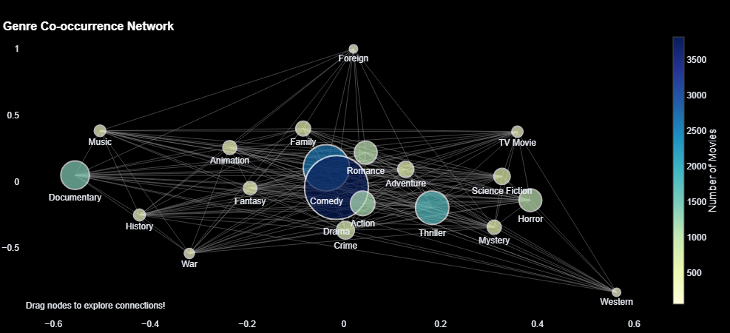
Co-occurrence Network

Slide 9
User Rating Pattern Analysis

Slide 10
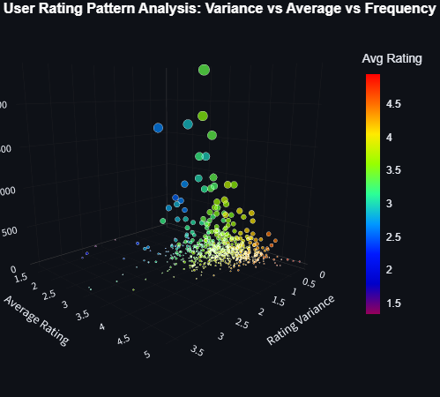
User rating 3D Scatter Plot

Slide 11
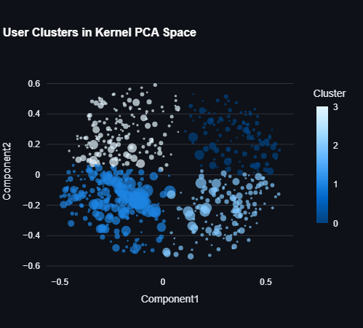
User Cluster Classification

Slide 12
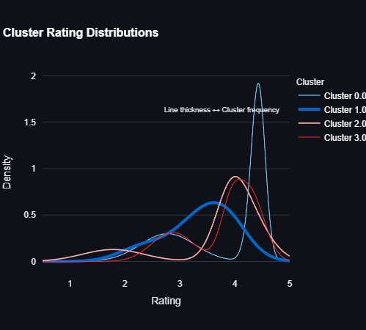
Distribution of Cluster centres

Slide 13
Top Rated Movies By Year & Popularity Trends

Slide 14
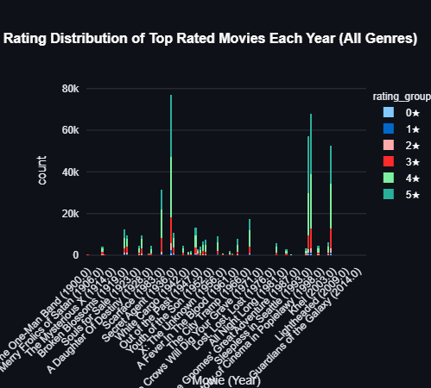
Bar Chart

Slide 15
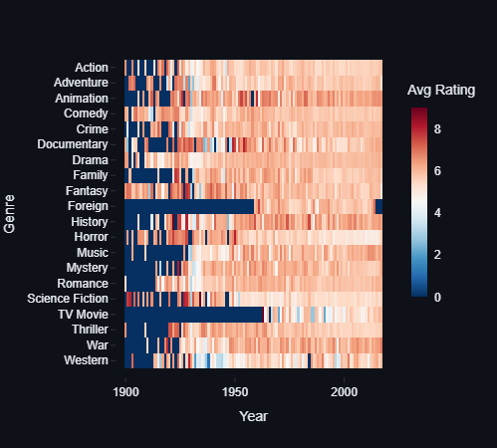
HeatMap

Slide 16
Geographical Revenue Analysis

Slide 17
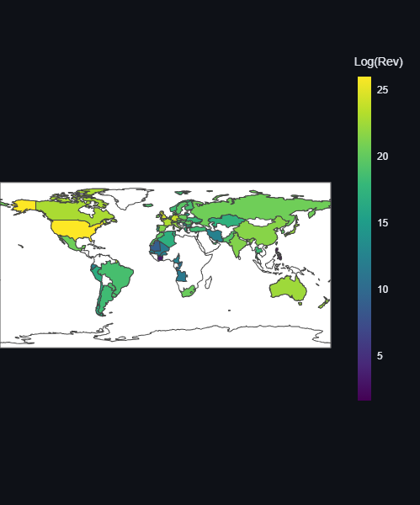
Choropleth Map

Slide 18
Rating-Revenue Disparity Analysis

Slide 19
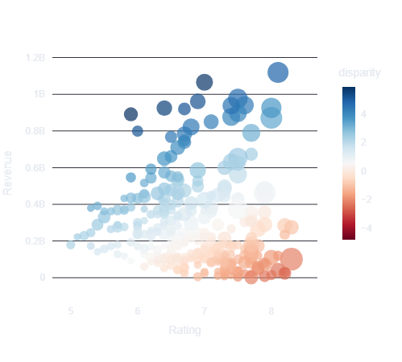
Scatter Plot

Slide 20
Budget-Revenue Disparity Analysis

Slide 21
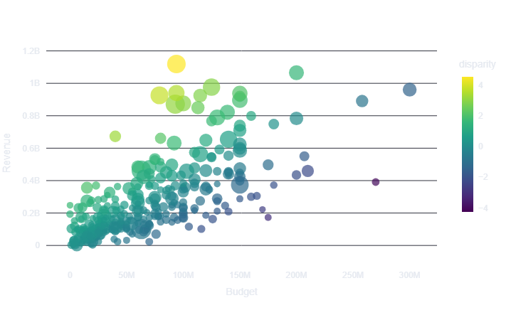
Scatter Plot

Slide 22
Polarized Rating Analysis

Slide 23
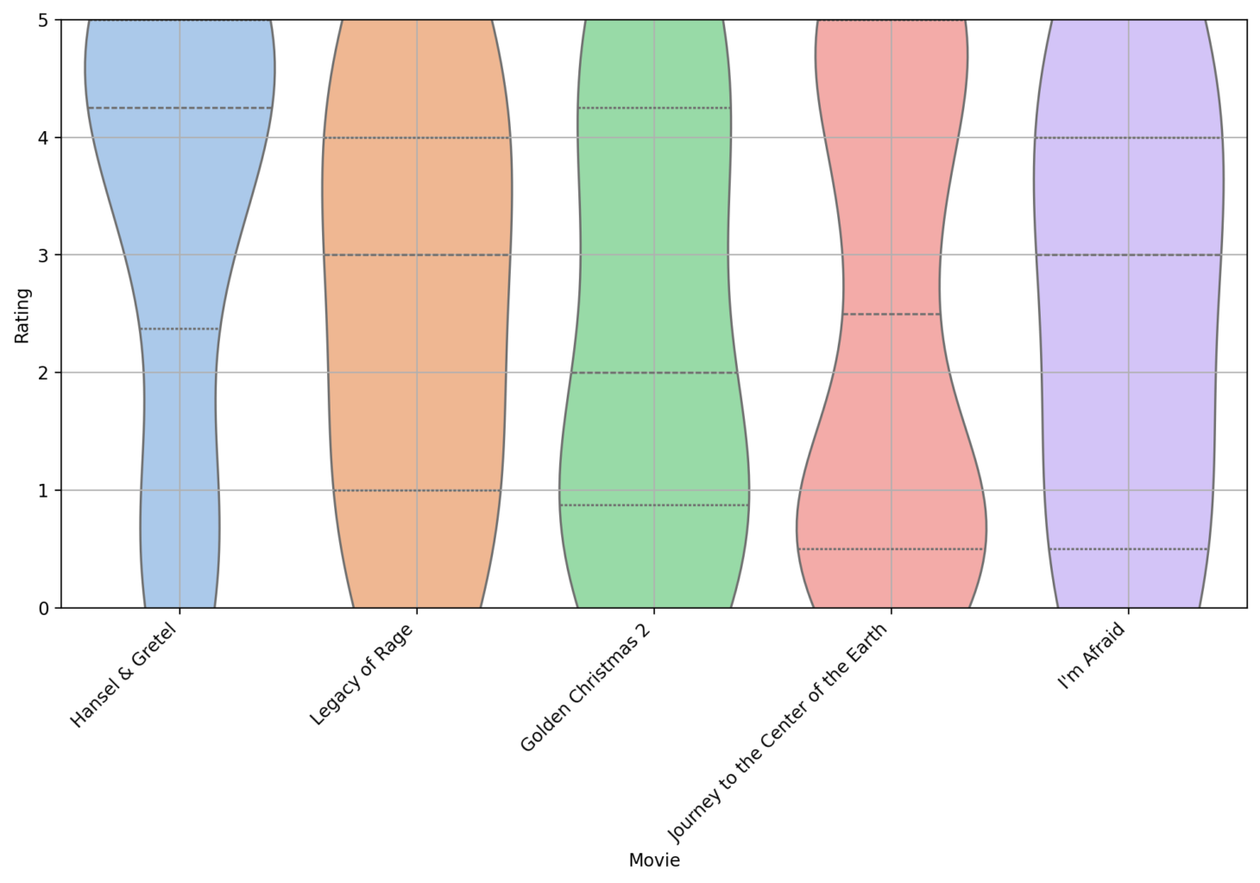
Violin Plot

Slide 24
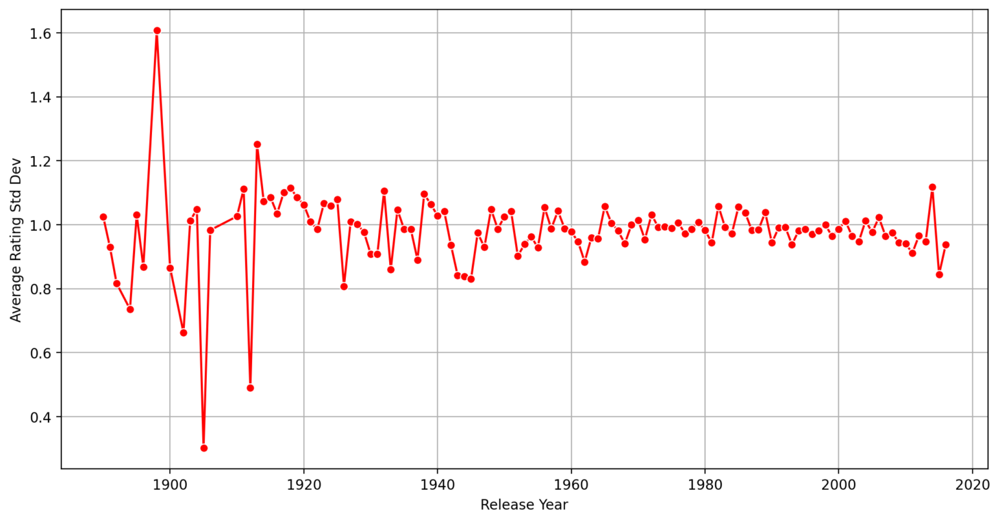
Line Chart

Slide 25
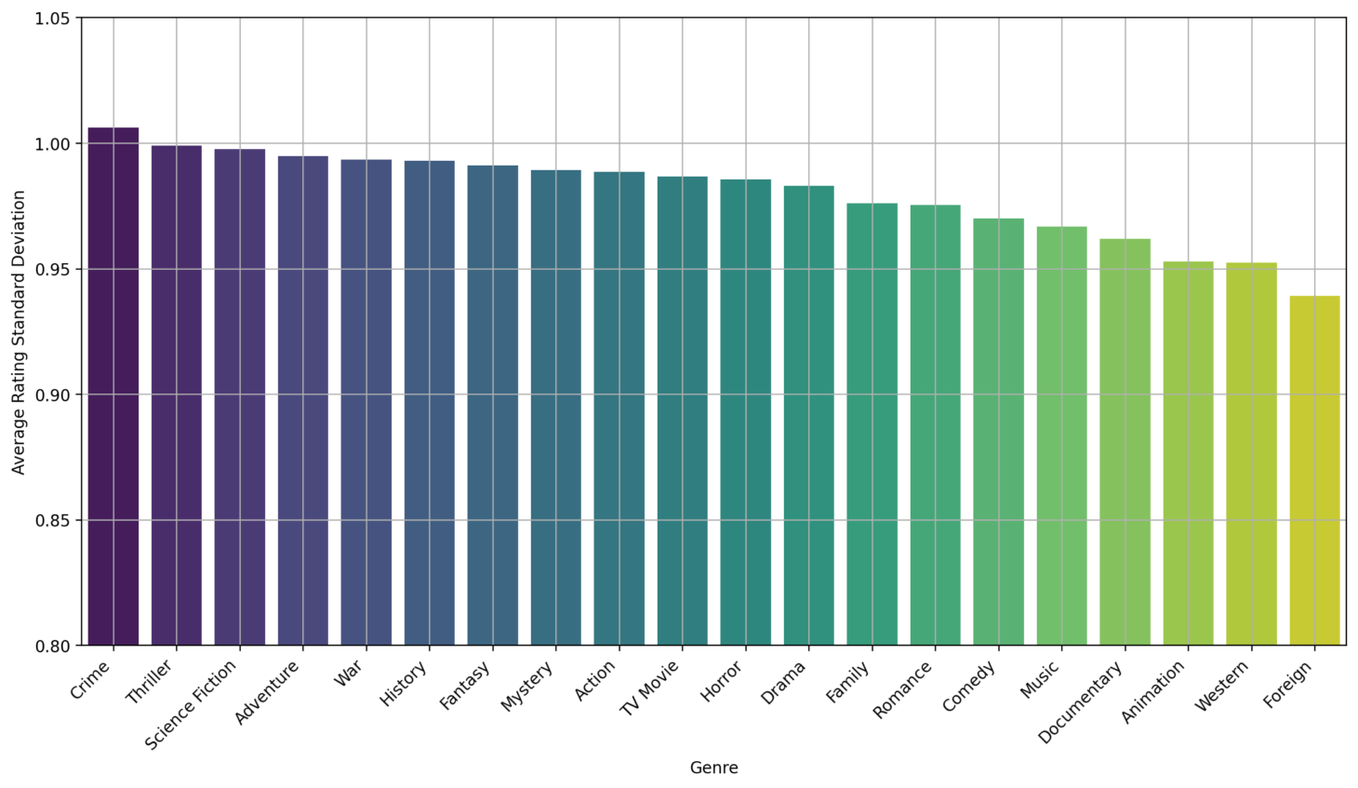
Bar Chart

Slide 26
Franchise Performance Over Time

Slide 27
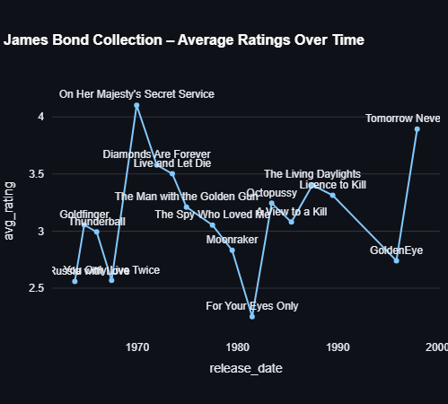
Line Chart

Slide 28
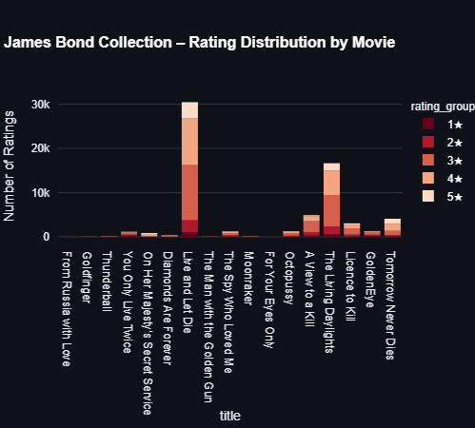
Bar Chart

Slide 29
Director Vs Actor Performance

Slide 30
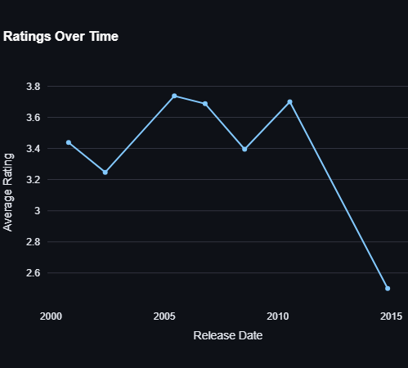
Line Chart

Slide 31
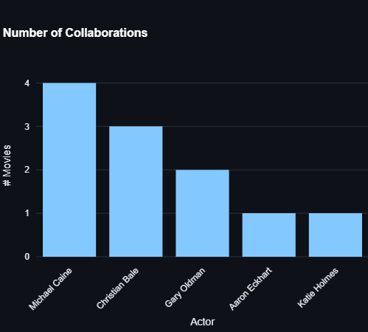
Bar Chart

Slide 32
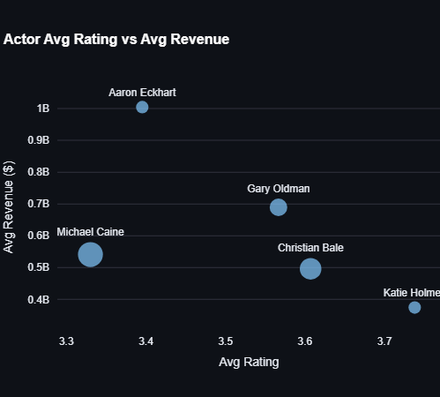
Scatter Plot

Slide 33
Demo and
Display

Slide 34
Contributions
Genre Evolution Over Time: Chitte Charan Kumar Reddy (210293)
User Rating Behavior Analysis: Sajja Eswara Sai Raghava (210904)
Top-Rated Movies by Year & Popularity Trends: Anumulapuri Sai Sreeja (210168)
Geographical Revenue Analysis: Sawan H N (210952)
Ratings-Revenue & Budget-Revenue Disparity Analysis: Saumya Gupta (210944)
Rating Polarization Analysis: Harshini Dola (210418)
Movie Franchise Performance Over Time: Ogirala Deeven Kumar (210681)

Slide 35
THANK YOU!

